Slide 1


Prayas Pens and Plastics
Established: 1979, Mumbai, India​
Expertise: Pen manufacturing and packaging​
Operations: Multiple factories and units​
In House: 80% of operations​
Focus: B2B sector​

Slide 2
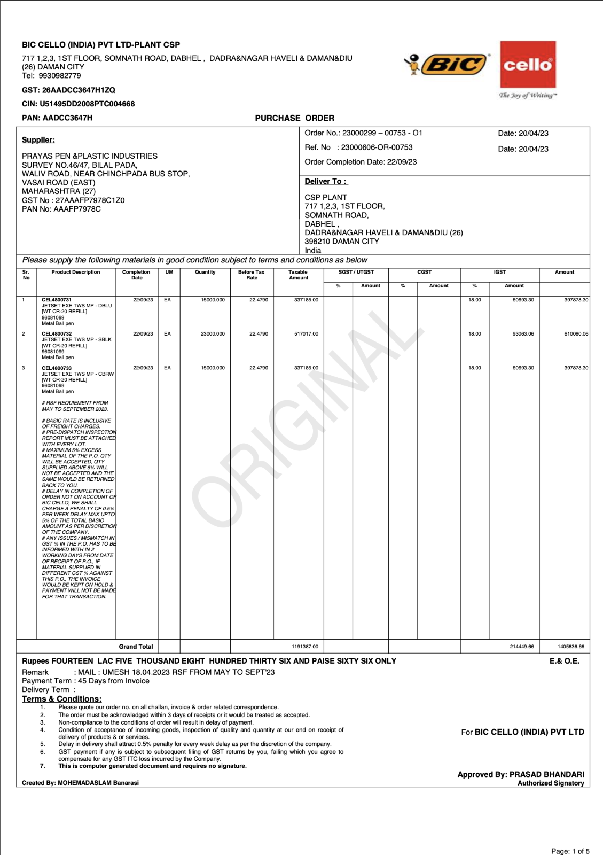
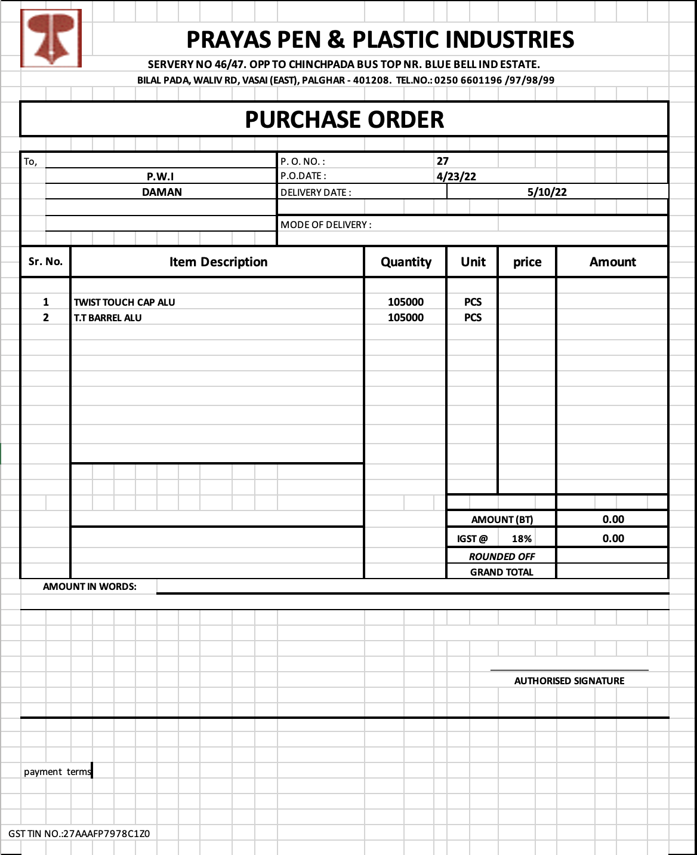
Current Data Storage Mechanism

Slide 3
Business Process
Project Objectives
Contractual Pricing
Purchase Orders
Raw Material Procurement
Manufacturing
Delivery
Data Standardization
Digital Transformation Initiation
Data Monetization

Slide 4
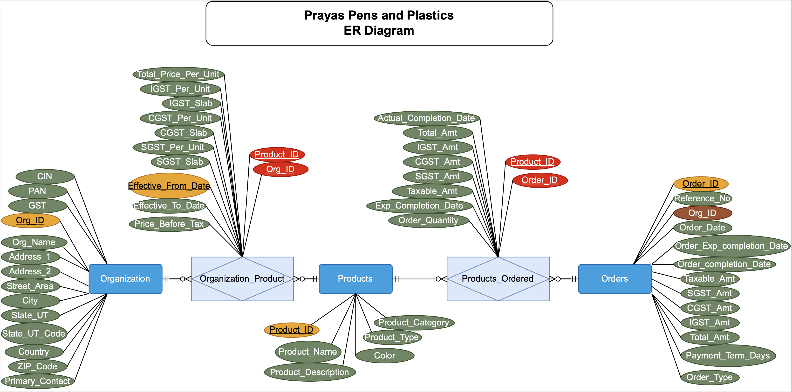
Conceptual Data Modeling

Slide 5
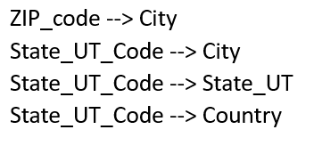
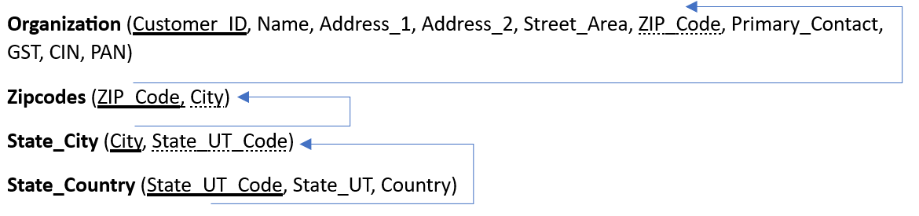
Normalization
All tables are in 3 NF except Organization.
Transitive dependencies in Organization:-
Conversion to 3 NF
NOTE** Our clients, prioritizing simplicity and seamless daily operations, preferred a less complex database structure over the initially recommended 3rd Normal Form (3NF) design. With fewer than 200 customer records, they saw limited urgency in addressing data redundancy within their organization table.

Slide 6
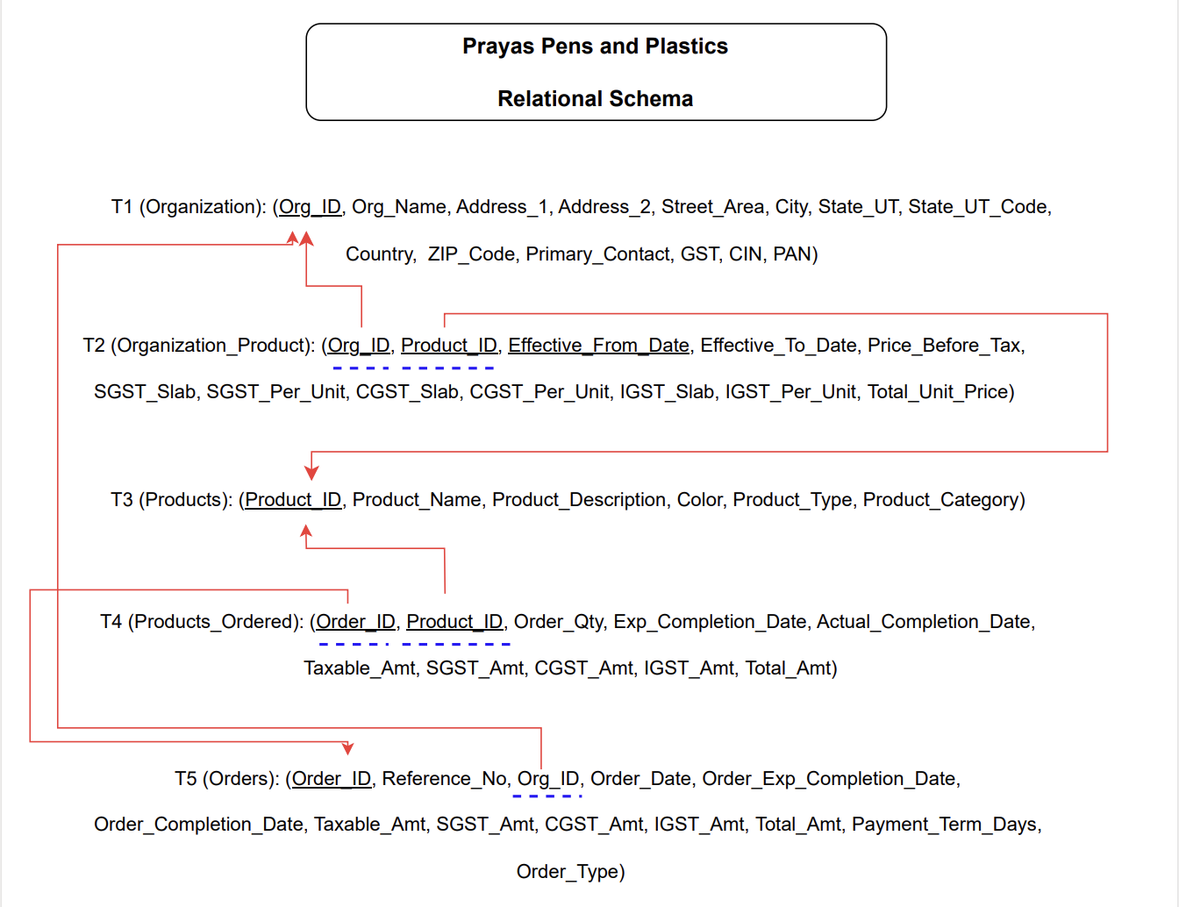
Relational Schema

Slide 7

Data Insight Queries
Insights provided to clients –
Clients that order the most from Prayas
Suppliers that Prayas orders the most from
Information about Revenue, AOV and Order Count
Market Basket Analysis
Order delivery estimation
Products Analysis
Top products
Never been ordered before

Slide 8
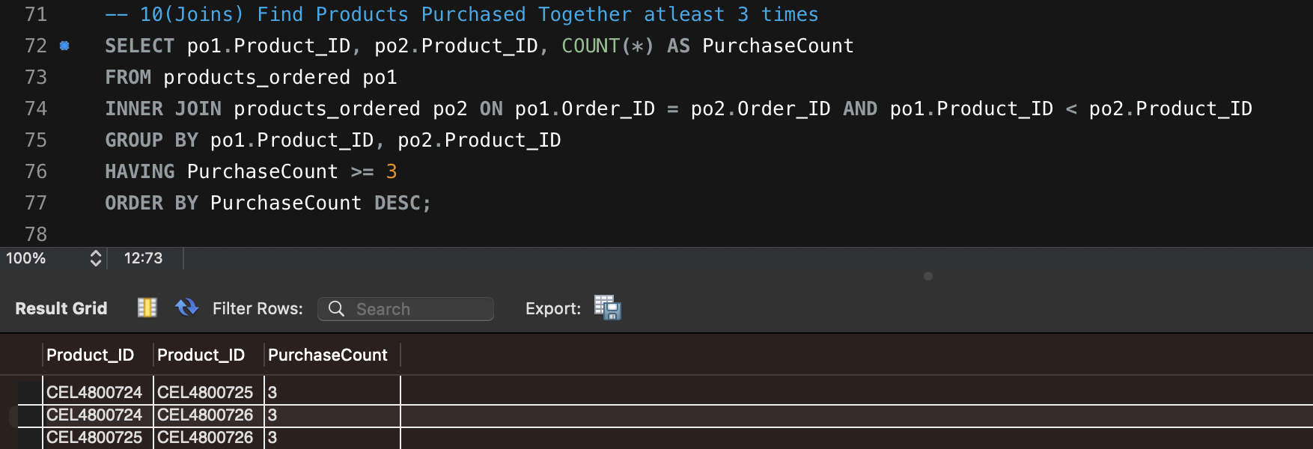
Market Basket Analysis
Market basket analysis identifies associations between products frequently purchased together.
For Prayas, it would aid in–
Inventory Optimization: Minimizes excess stock, maximizes sales
Cross-Selling Opportunities: Boosts revenue through complementary sales
Targeted Marketing: Precision in promotional strategies

Slide 9
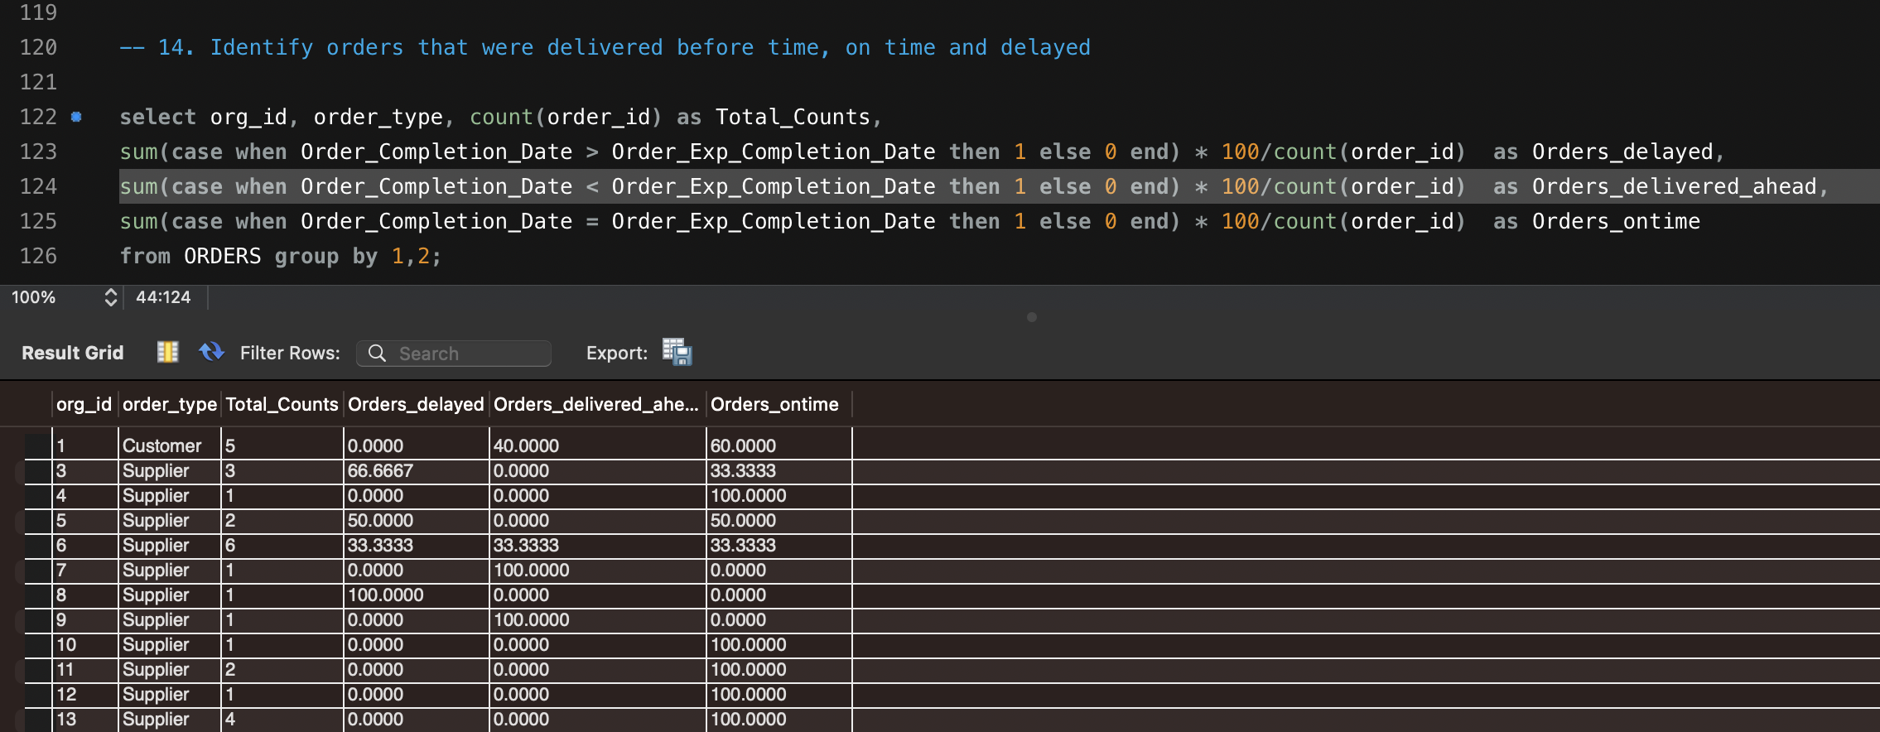
Delivery Performance Analysis
Delivery performance analysis helps Prayas understand the percentage of orders delivered before time, on time and delayed. With this information, Prayas can –
Optimized Operations: Identifies and resolves bottlenecks in the manufacturing and delivery process, ensuring streamlined operations.
Customer Satisfaction: Ensures timely and accurate deliveries, enhancing customer experience and loyalty.
Cost Efficiency: Reduces expenses associated with delayed deliveries, rework, and customer complaints, leading to cost savings.
Resource Allocation: Allows for better allocation of resources by identifying areas that need improvement in the delivery process.

Slide 10
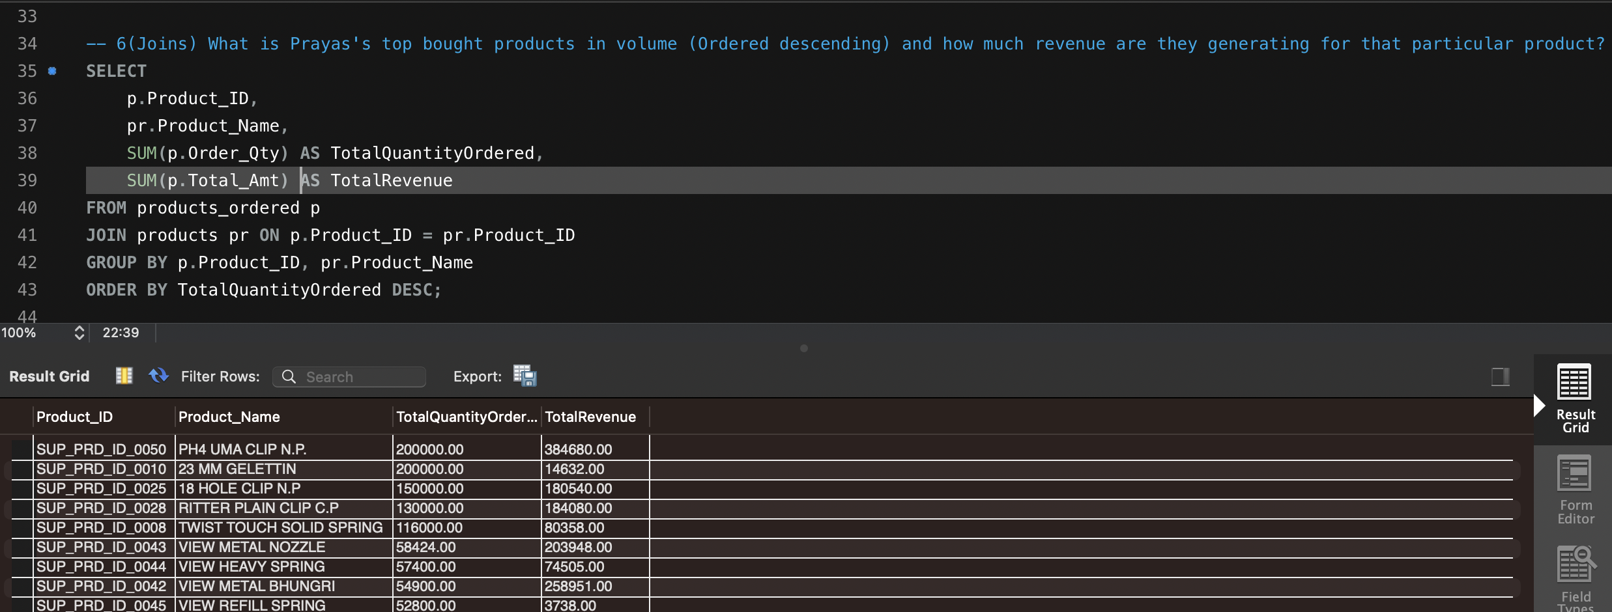
Product Analysis
Product analysis includes an understanding of top selling products and the ones that do not sell –
Inventory Focus: Directs attention to high-demand items
Profit Maximization: Enhances revenue by promoting best-sellers
Stock Clearance: Flags slow-moving products for adjustment

